Slide 1
Unit: Macromolecules: polymers, proteins and carbohydrates
Subject Matter:
describe, using equations, how addition polymers can be produced from their monomers including polyethene (LDPE and HDPE), polypropene and polytetrafluorethene
describe, using equations, how condensation polymers, including polypeptides (proteins), polysaccharides (carbohydrates) and polyesters, can be produced from their monomers
discuss the advantages and disadvantages of polymer use, including strength, density, lack of reactivity, use of natural resources and biodegradability
describe the condensation reaction of 2-amino acids to form polypeptides (involving up to three amino acids), and understand that polypeptides (proteins) are formed when amino acid monomers are joined by peptide bonds
describe the condensation reaction of monosaccharides to form disaccharides (lactose, maltose and sucrose) and polysaccharides (starch, glycogen and cellulose), and understand that polysaccharides are formed when monosaccharides monomers are joined by glycosidic bonds.

Slide 2
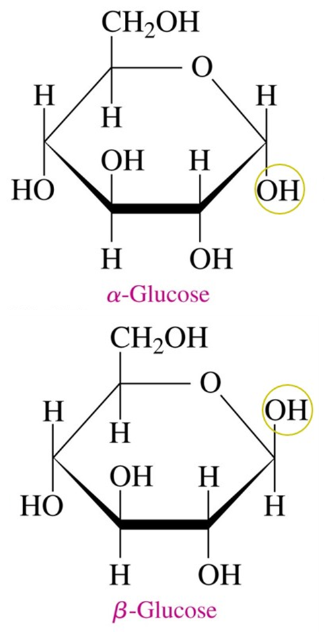
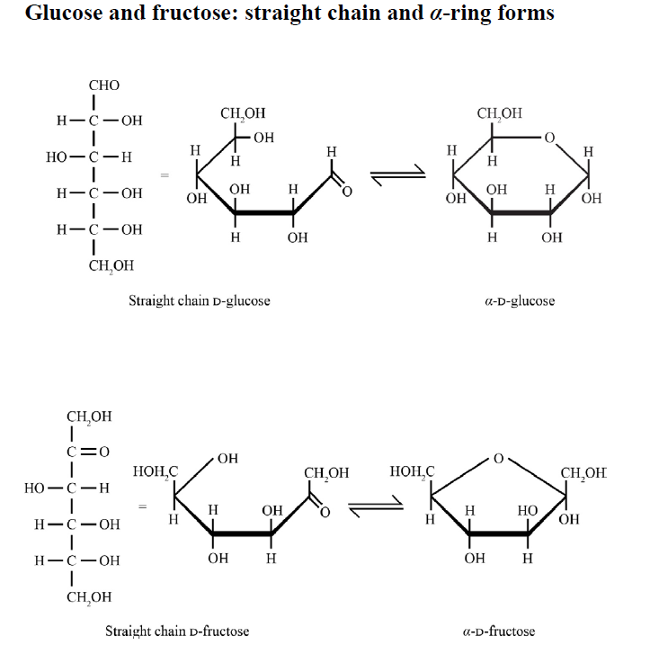
Monosaccharides present in Formula book
Glucose comes in two forms

Slide 3
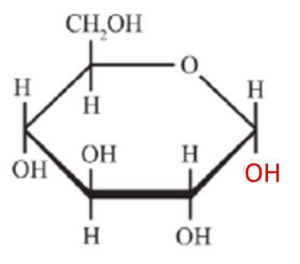
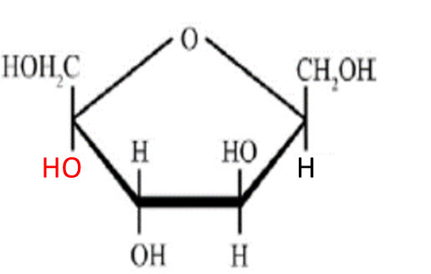
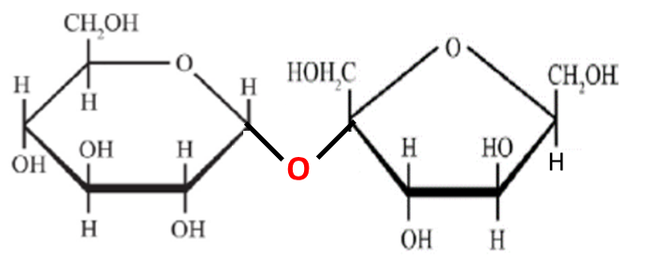
describe, using equations, how condensation polymers, including polypeptides (proteins), polysaccharides (carbohydrates) and polyesters, can be produced from their monomers (Pearson 535)
Linking monosaccharides
Two monosaccharides can join together to in a condensation reaction to form a glycosidic bond.
+
+ H₂O
α-Glucose + Fructose → sucrose + water

Slide 4
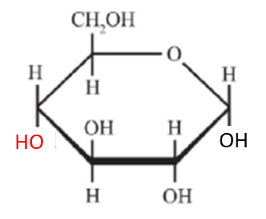
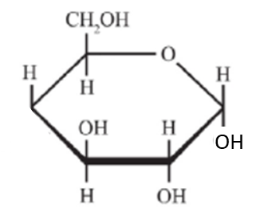
describe the condensation reaction of monosaccharides to form disaccharides (lactose, maltose and sucrose) and polysaccharides (starch, glycogen and cellulose), and understand that polysaccharides are formed when monosaccharides monomers are joined by glycosidic bonds. (Pearson 402-404)
Disaccharide: Maltose
A α-glucose and α-glucose can join together to in a condensation reaction to form a glycosidic bond and make MALTOSE
+
+ H₂O
O
α-Glucose + α-Glucose → maltose + water

Slide 5
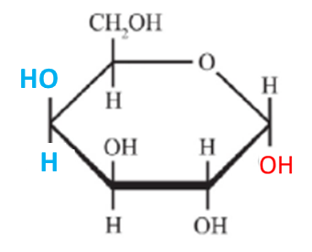
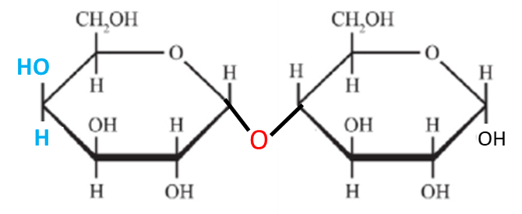
describe the condensation reaction of monosaccharides to form disaccharides (lactose, maltose and sucrose) and polysaccharides (starch, glycogen and cellulose), and understand that polysaccharides are formed when monosaccharides monomers are joined by glycosidic bonds. (Pearson 402-404)
Disaccharide: Lactose
A galactose and α-glucose can join together to in a condensation reaction to form a glycosidic bond and make Lactose
+
+ H₂O
Galactose + α-Glucose → Lactose + water

Slide 6
describe the condensation reaction of monosaccharides to form disaccharides (lactose, maltose and sucrose) and polysaccharides (starch, glycogen and cellulose), and understand that polysaccharides are formed when monosaccharides monomers are joined by glycosidic bonds. (Pearson 402-404)
Disaccharide: Sucrose
A α-glucose and fructose can join together to in a condensation reaction to form a glycosidic bond and make Sucrose
+
+ H₂O
α-Glucose + Fructose → sucrose + water

Slide 7
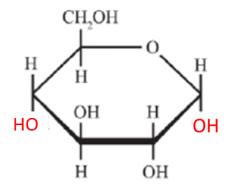
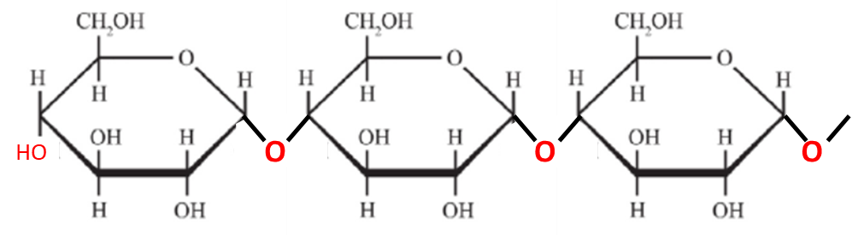
describe the condensation reaction of monosaccharides to form disaccharides (lactose, maltose and sucrose) and polysaccharides (starch, glycogen and cellulose), and understand that polysaccharides are formed when monosaccharides monomers are joined by glycosidic bonds. (Pearson 402-404)
Polysaccharides:
Many monosaccharides can join together to in condensation reactions to form a polysaccharide such as Starch
What glucose is being used here?
+
+
+…
α-glucose
+ n-1H₂O
Starch

Slide 8
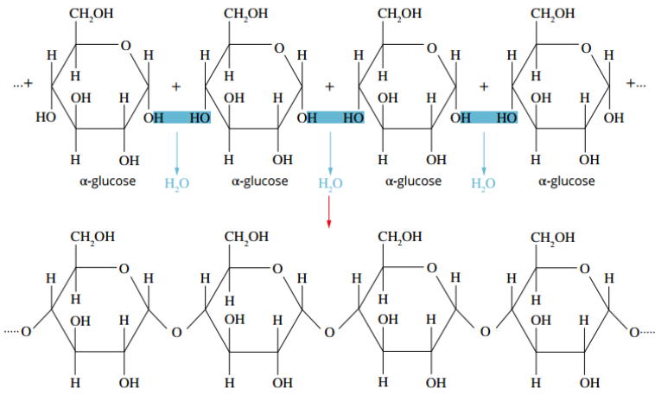
describe the condensation reaction of monosaccharides to form disaccharides (lactose, maltose and sucrose) and polysaccharides (starch, glycogen and cellulose), and understand that polysaccharides are formed when monosaccharides monomers are joined by glycosidic bonds. (Pearson 402-404)
Starch (Amylose)
Made from α – glucose
1-4 glycosidic bonds
Helix coil
Allows close packing and strong intermolecular forces
Less soluble in water
Slower digestion

Slide 9
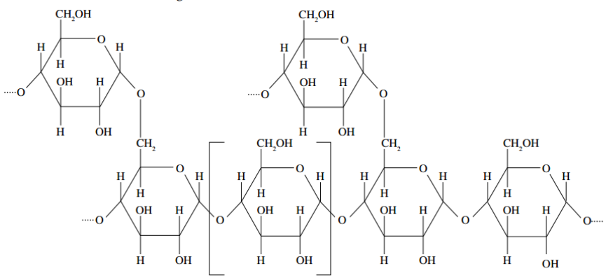
describe the condensation reaction of monosaccharides to form disaccharides (lactose, maltose and sucrose) and polysaccharides (starch, glycogen and cellulose), and understand that polysaccharides are formed when monosaccharides monomers are joined by glycosidic bonds. (Pearson 402-404)
Amylopectin
Made from α – glucose
1-4 glycosidic bonds AND 1-6 α-glucose linkages.
Branched structure forming compact spirals
Not rigid due to branching
Branching reduces intermolecular forces
More soluble in water
Faster digestion

Slide 10
describe the condensation reaction of monosaccharides to form disaccharides (lactose, maltose and sucrose) and polysaccharides (starch, glycogen and cellulose), and understand that polysaccharides are formed when monosaccharides monomers are joined by glycosidic bonds. (Pearson 402-404)
Glycogen
Made from α – glucose
Highly Branched structure
Not rigid due to branching
Branching reduces intermolecular forces
More soluble in water
Faster digestion
Animals use glycogen as storage

Slide 11
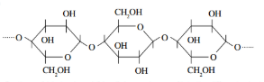
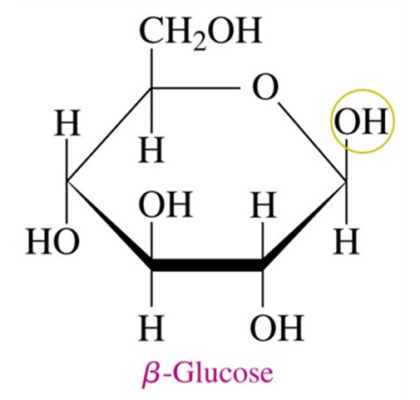
describe the condensation reaction of monosaccharides to form disaccharides (lactose, maltose and sucrose) and polysaccharides (starch, glycogen and cellulose), and understand that polysaccharides are formed when monosaccharides monomers are joined by glycosidic bonds. (Pearson 402-404)
Cellulose
Made from β – glucose
1-4 glycosidic bonds
Straight chain forming microfibrils
Alternating position of CH₂OH and OH enables results in hydrogen bonds.
Strong intermolecular forces
Not soluble in water
Humans cannot digest cellulose
This glucose has to flip for bond to form

Slide 12

CARBOHYDRATE SUMMARY

Slide 13
PROTEINS
Subject Matter:
describe, using equations, how addition polymers can be produced from their monomers including polyethene (LDPE and HDPE), polypropene and polytetrafluorethene
describe, using equations, how condensation polymers, including polypeptides (proteins), polysaccharides (carbohydrates) and polyesters, can be produced from their monomers
discuss the advantages and disadvantages of polymer use, including strength, density, lack of reactivity, use of natural resources and biodegradability
describe the condensation reaction of 2-amino acids to form polypeptides (involving up to three amino acids), and understand that polypeptides (proteins) are formed when amino acid monomers are joined by peptide bonds
describe the condensation reaction of monosaccharides to form disaccharides (lactose, maltose and sucrose) and polysaccharides (starch, glycogen and cellulose), and understand that polysaccharides are formed when monosaccharides monomers are joined by glycosidic bonds.

Slide 14
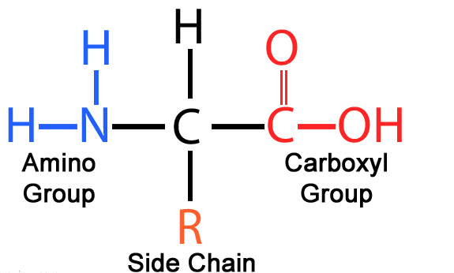
Structure of AMINO ACIDS
There are 20 amino acids that make up all proteins in the human body
Every amino acid has a amino group (-NH₂) and a carboxyl group (-COOH)
Different amino acids have different side chains (R groups) on the second carbon.
This is why they are called 2-amino acids or α-amino acids as the side group is attached to the second carbon

Slide 15
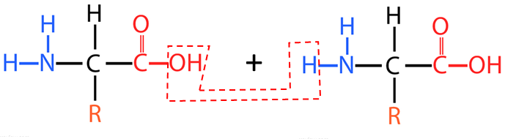
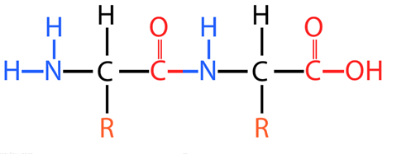
describe, using equations, how condensation polymers, including polypeptides (proteins), polysaccharides (carbohydrates) and polyesters, can be produced from their monomers
Dipeptides
The condensation reaction between the amino functional group in one 2-amino acid and the carboxyl functional group in the other 2-amino acid forms a peptide functional group.
+ H₂O

Slide 16
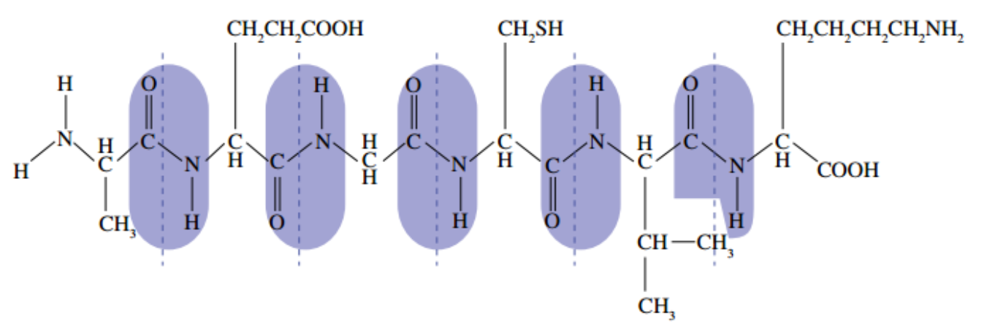

describe the condensation reaction of 2-amino acids to form polypeptides (involving up to three amino acids), and understand that polypeptides (proteins) are formed when amino acid monomers are joined by peptide bonds
Polypeptides: Proteins
Polypeptides are formed when amino acids react in a condensation reaction. Polypeptides with more than 50 amino acids are called proteins, and are represented using a three-letter code for each amino acid written in sequence.

Slide 17

Protein SUMMARY

